Slide 1


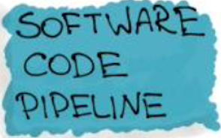
ML ENGINEERING WORKFLOW
COMPETITOR DATA
Gas dataset
Power dataset
FEATURE ENGINEERING
Validity period
Base/ Spot/ Peak prices
Strategy index based on average supplier ranking
Version Control [Git]
EXTERNAL DATA?!
Household energy consumption
MONITORING & LOGGING
Dssd
ds
ENERGY PRICES
Year/ day ahead future prices
Spot prices
DATA WRANGLING
Removing invalid dates (9999-12-31)
Formatting data types
Removing NAN values
Indexing dates
EXPLORATION & VALIDATION
Aggregating duplicate values
Descriptive Analysis
Basic statistics
Figuring out correlations between features
Deriving first insights based on the average distribution of suppliers’ average ranking
ds
MASTER DATA SET
Merging the competitor and price data sets (for both power and energy)
TRAIN
80%
ds
TEST
20%
ds
APPROACHES
Figure out the most important instruments for suppliers via reaction to price changes ?!
How regularly do suppliers update their prices (validity period)
Is there a correlation between a main supplier and followers?
Moving averages as a proxy for pricing strategy
Moving average time window (e.g. 7 days for short-term period or longer for wider trends)
- Segmentation of postcodes (what’s the effect on pricing strategy?)
Feature Engineering
Hyperparameter Tuning
Best model selection
Model performance metrics
Accuracy
Prescision
Recall
MODEL ENGINEERING
Clustering (Unsupervised)
Regression
Reinforcement Learning
MODEL EVALUATION
Dssd
ds
MODEL PACKAGING
Dssd
ds
MODEL
Dssd
ds
CODE
BUILD & INTEGRATION TESTING
DEPLOYMENT

